Slide 1
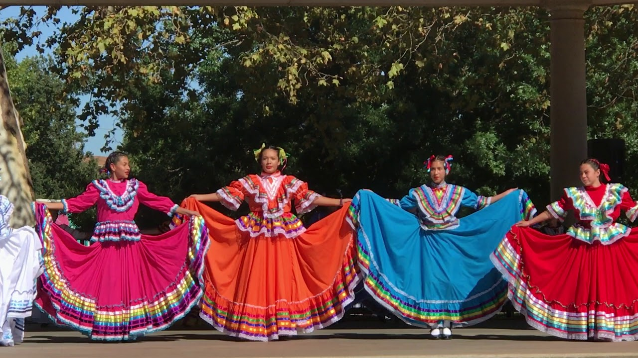
Baile Folklórico

Slide 2

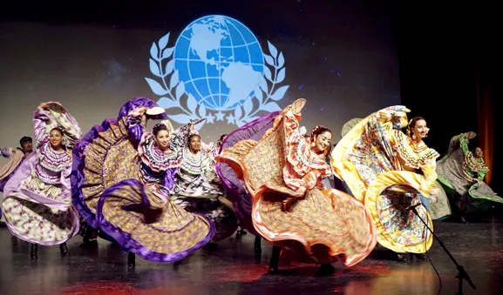
Baile Folklórico
Baile Folklórico includes many different types of folk dances from Hispanic cultures across many countries, particularly in Mexico, Spain, and Puerto Rico. Not all Baile Folklórico is the same.
Though the dances differ from region to region, the basic steps and style of dances are often similar.
Dance movements can be compared to tap dancing, with lots of rhythmic stomping.
Dance movements are often repeated multiple times before switching to a different movement
The music is energetic and joyful, and written specifically for dancing

Slide 3
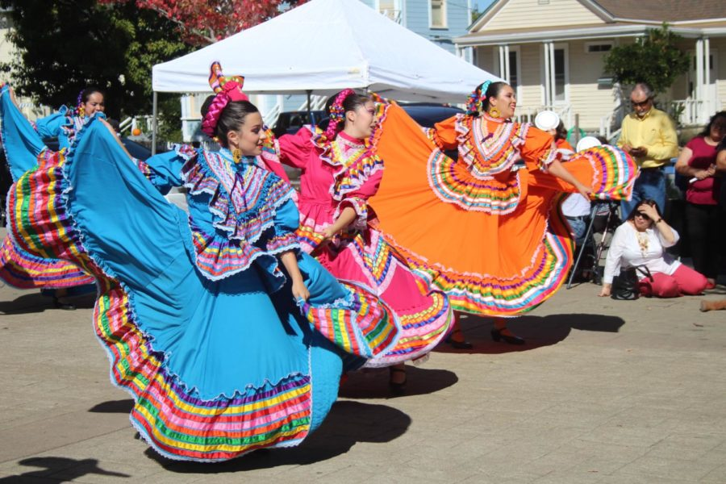
Baile Folklórico
The costumes are different depending on which country or state the dancers are from, and are used to tell stories about the community
Costumes are used as an important part of the movement, particularly the skirts for the women
Other props, such as machetes, brooms, or other items are sometimes used by the male dancers to tell the story of the dance.
The rhythmic stomping, the music, and the costumes are all clues about where a particular dance comes from.

Slide 4
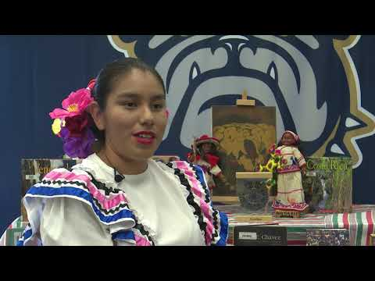

Slide 5
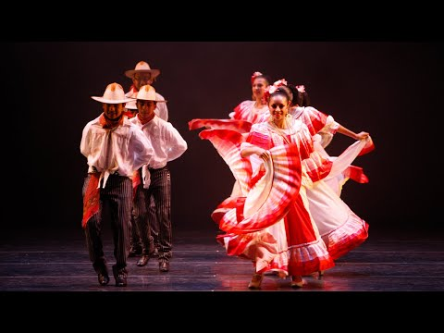
Notes:
In class, we watched the first 1:48 of this video.

Slide 6
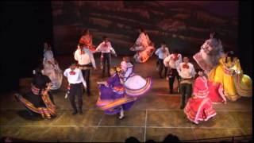

Slide 7
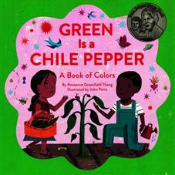
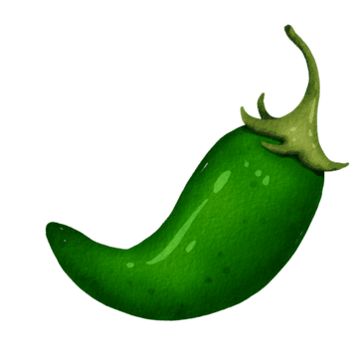
Green is a Chile Pepper Book by Rosanne Greenfield Thong
Kindergarten:
2 Moves (count to 8 for each one) Perform your movement in an ABAB pattern

Slide 8
Green is a Chile Pepper Book by Rosanne Greenfield Thong
First Grade
4 Moves (count to 8 for each one)
At least one of your moves needs to be a locomotor movement. The rest can be stationary.

Slide 9
Green is a Chile Pepper Book by Rosanne Greenfield Thong
Second Grade
4 Moves (count to 8 for each one)
Both Locomotor and Stationary Use all three levels: High, Medium, Low

