Slide 1
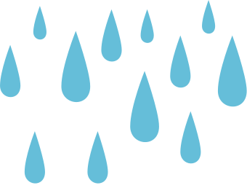
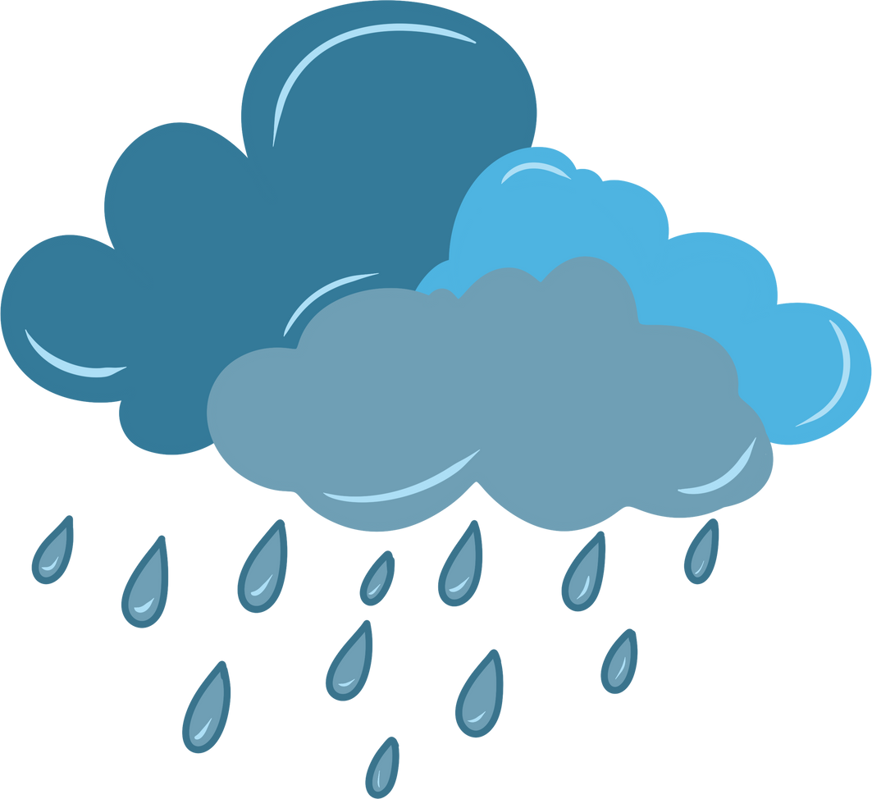

Rain Rain
Go Away
Orff Schulwerk
Lesson
by Crystal Pridmore
A Playful and Interactive Approach to Music Learning

Slide 2
Listen to the Rain

Slide 3
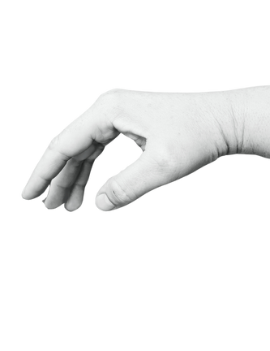

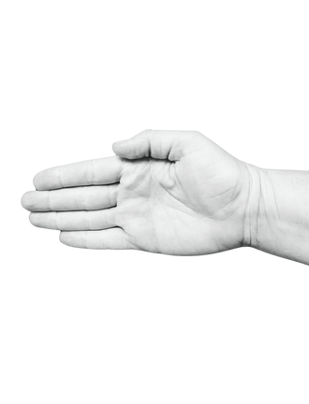
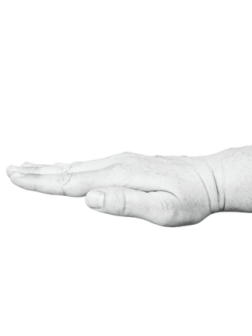
Rain Rain
Go Away
La
Sol
Mi
Rain
Rain
Go a-
way
Come a-
gain
a-
noth-er
day

Slide 4


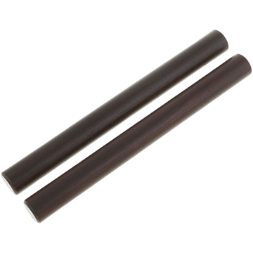

Exploring Rain Sounds
Can you make rain sounds with your....
Hands
Feet/ Legs
Body
Breath
Rhythm Sticks

Slide 5
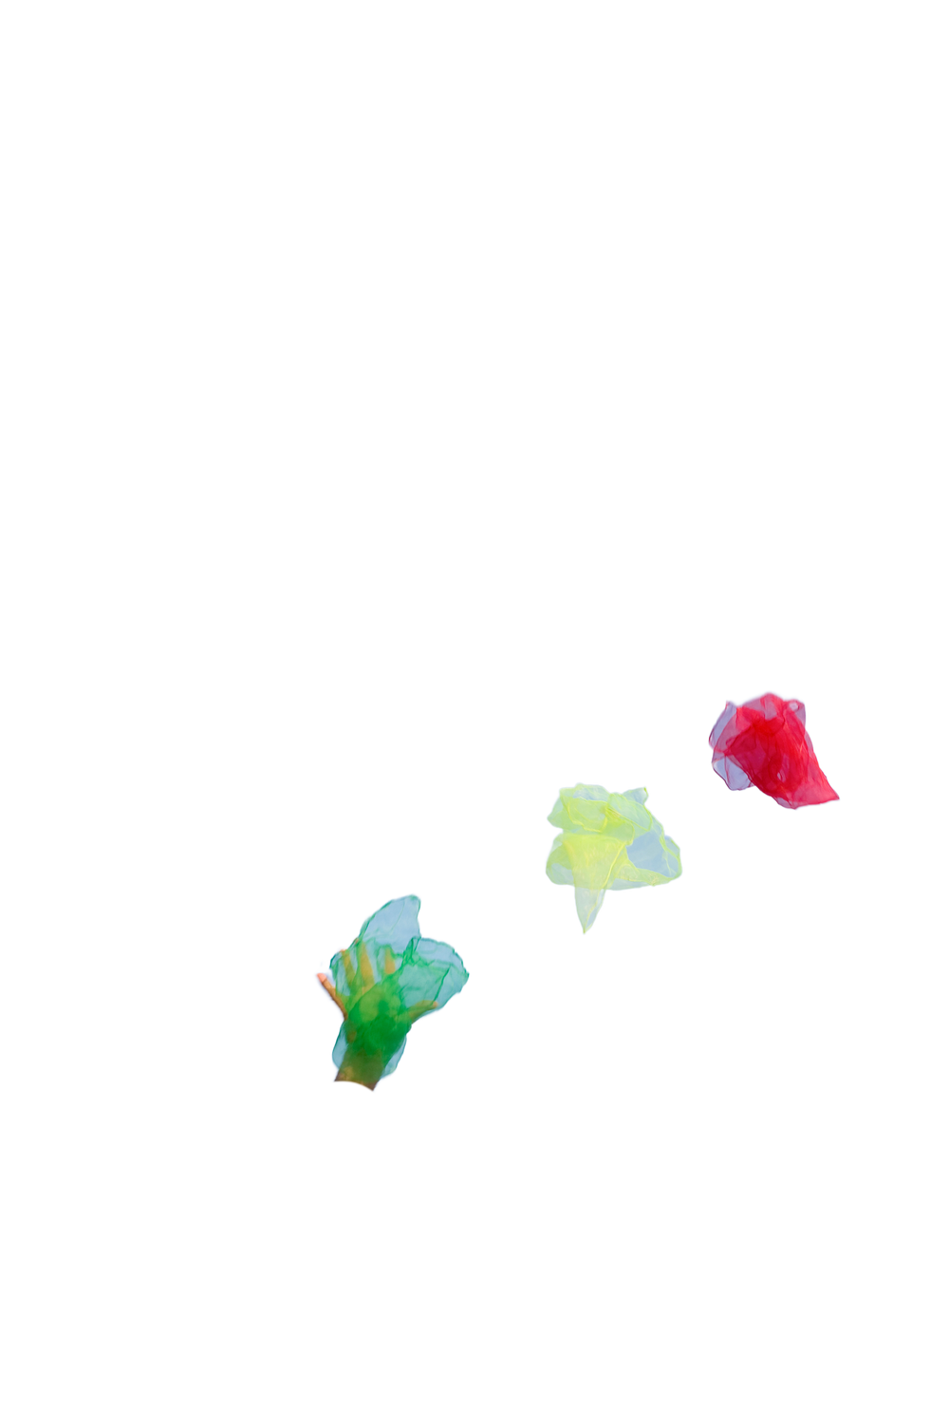
Performing the Rain Piece
A
B
A

Slide 6
Create Your Own Raindrop Rhythm

Slide 7


Create Your Own Raindrop Rhythm
Rain
Raindrop
Rain
Rain

